Slide 1
Spatial Analysis
What is spatial analysis?
Spatial research questions
Data classification

Slide 2
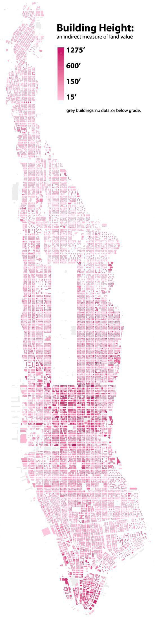
WHAT IS GIS?
Geographic Information Systems (Science)
GIS allows
you
to
process,
analyze
and visualize
information about
the
Earth’s
surface.
GIS is
utilized to flexible system
know
“what
is where,when”
and is a
that
allows
you to
study spatial
relationships,
PAST
AND PRESENT.
It is NOT the
software that we
use to map data.
“Everything is
but
related
to everything
else,
near
things
are more
related than distant things.”
(First law of geography, Waldo Tobler)

Slide 3
ASKING
Location
Where is it?
Why is it here or there?
How much of it is here or there?
Geographic association
What else is near it?
What is absent in its presence?
Geographic change
Has it always been here?
How has it changed over time and space?
GEOGRAPHIC QUESTIONS

Slide 4
Research Question(s)
Research question framework:
What is the spatial relationship between x and y?
How does the location of x affect y?
What spatial factors contribute to x, y, z?
Who is affected by x, y, z, and where?
How is x distributed in y? Who has access to x?
Why does x occur in y areas at z time?
What is the spatial relationship between the moving population and the urban frontier from 1790-1860?
How are demographic characteristics of the population distributed across the urban and frontier regions?

Slide 5
Data
Putting raw data into classes/bins/categories.
Choropleth maps: thematic maps shaded with graduated colors to represent some statistical variable of interest
“How to Lie with Maps”
Why does classification matter for statistical maps?
Too many classes – confusing and too complex
Too few classes – oversimplify map and hide data trends
Source for following maps: https://www.citylab.com/design/2015/06/when-maps-lie/396761/
Classification

Slide 6
Data
Classification methods:
Equal interval
Quantile
Natural breaks (Jenks)
Standard Deviation
Classification

Slide 7
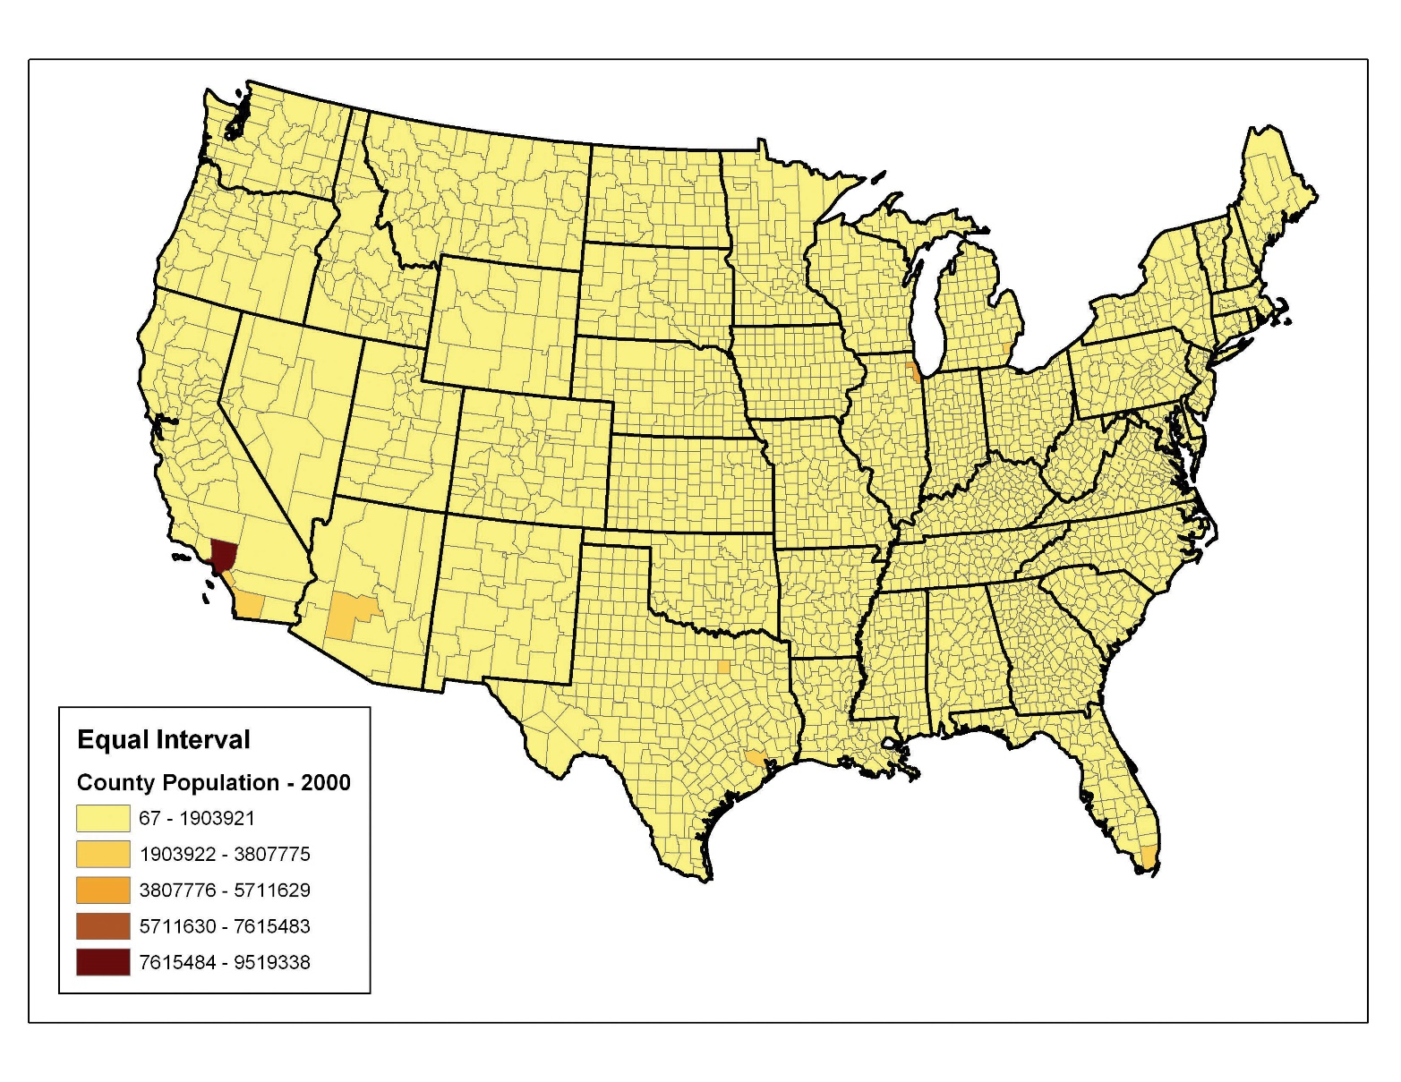
Equal intervals
Advantages: easy to understand
Disadvantages: many datasets will end up with most of data values in one or two classes

Slide 8
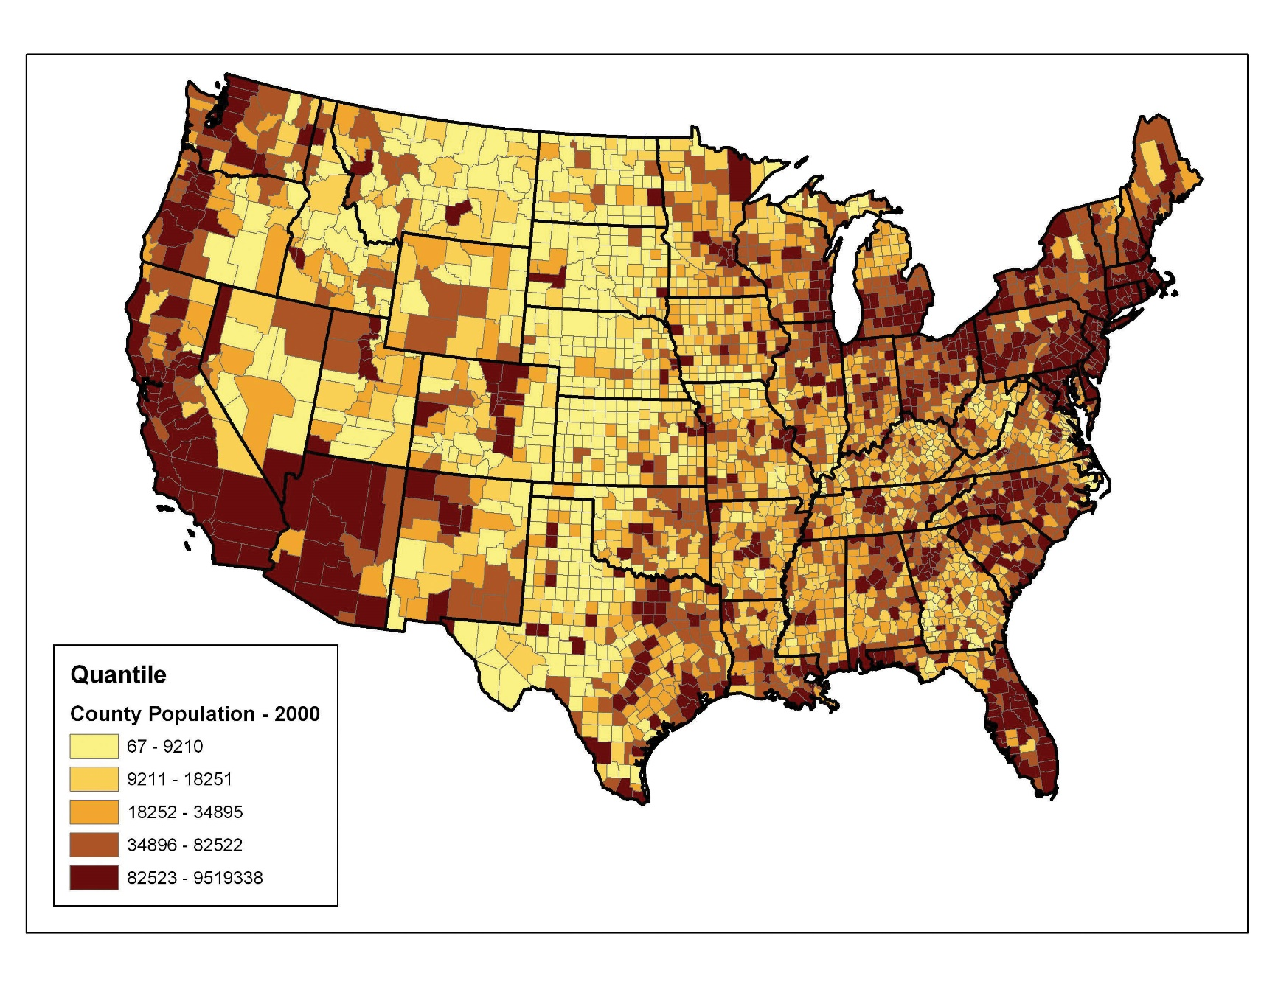
Quantiles
5 total classes
Advantages: highlights relative position of data values (bottom 20% of data, top 20% of data)
Disadvantages: features in the same class can have wildly different values, or values with small differences could be placed in different classes

Slide 9
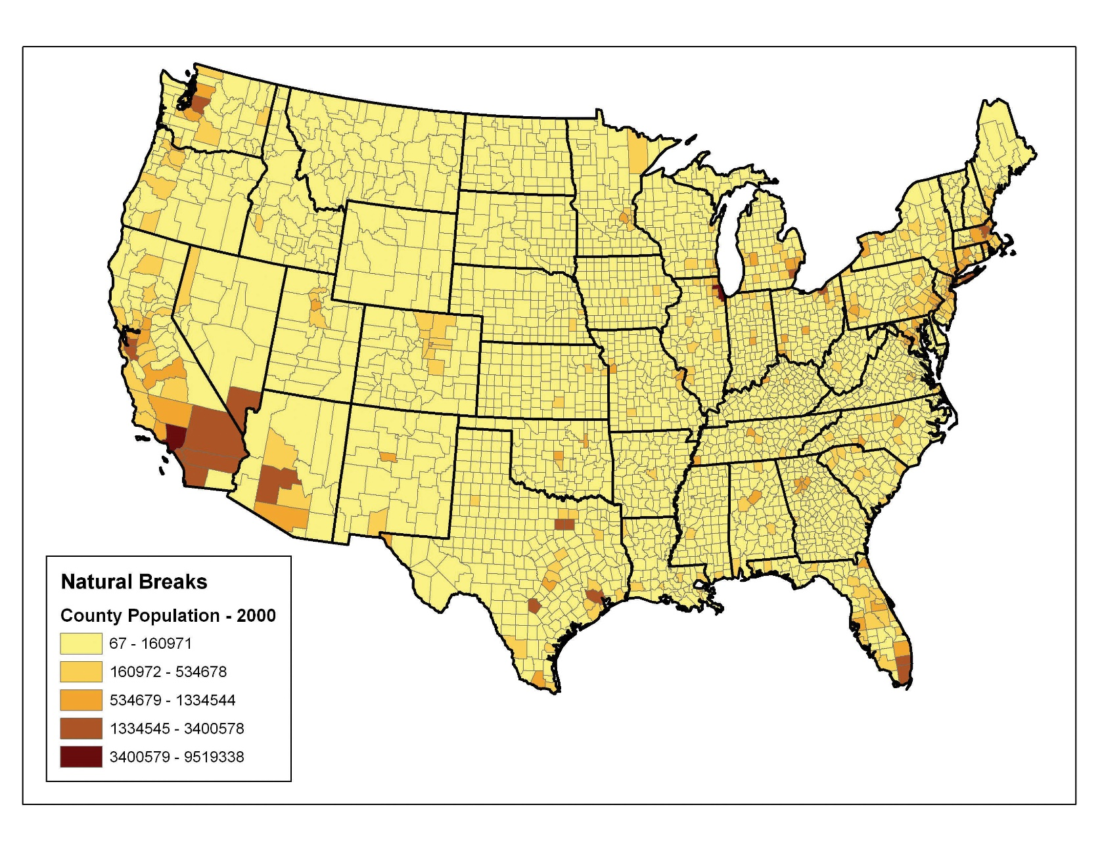
Natural Breaks
Algorithm to group values in classes separated by distinct break points
Disadvantages:
wildly varying number ranges in some cases (e.g. population with one class of 150,000 and another of 6,000,000)
Difficult to compare two maps since classes are so specific to dataset

Slide 10
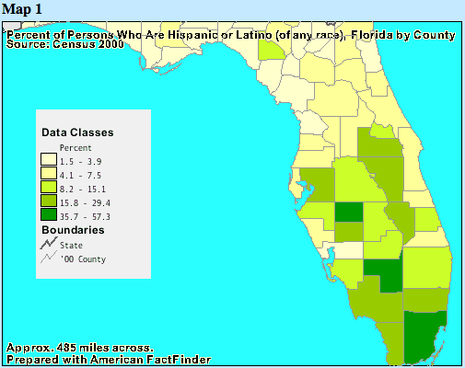
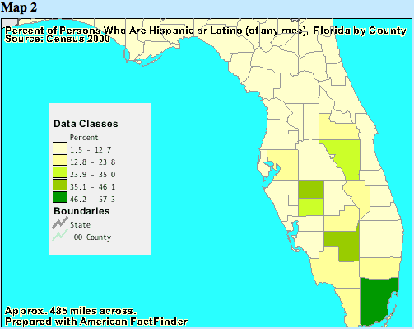
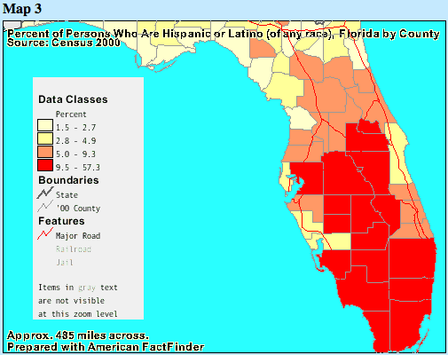
.
Natural Breaks
Equal Intervals
Quartiles

